Slide 1


Data Analytics – use cases
Babitha dharmaraJ

Slide 2
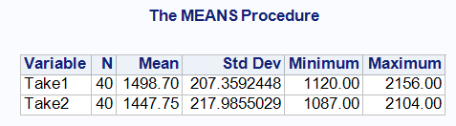
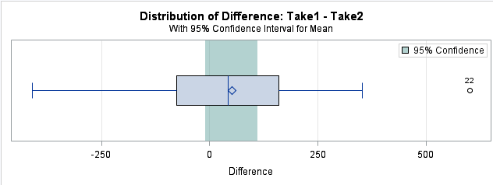
A Study for a large department store chain to suggest whether or not the chosen staff training improves the selling potentials.
Our aim is to compare the sales means of the trained and untrained salespersons.
From the initial analysis on sample mean and standard deviation of two samples:
Sample mean of the sales by trained(Take1) salespersons is £1498.7
Standard deviation of sales by trained (Take1) salespersons is 207.35
Sample mean of the sales by untrained (Take2) salespersons is £1447.75
Standard deviation of sales by untrained (Take2) salespersons is 217.986
At a first glance, sales look to be more by the trained salespersons on an average approximately £50 than that of untrained salespersons. Let us test if this is true.

Slide 3
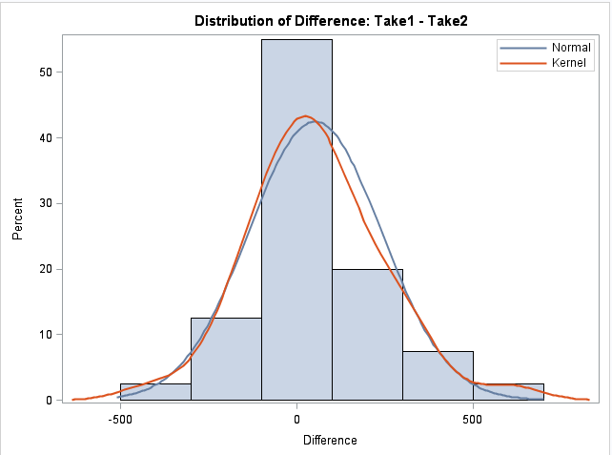
Verifying if a parametric statistical test will be valid:
Assumptions:
Dependent variable is continuous and near-normally distributed.
The observations are independent of each other.
Same measure (Sales receipt) on two different conditions(trained and untrained salespersons).
Hence, Paired samples t-test would be appropriate.
Let's also assume that:
i) Null Hypothesis H₀: true mean difference between take1 and take2 is Zero.
µ1 = µ2; D=0; No change in sales.
ii) Alternate Hypothesis H₁: µ1 ≠ µ2; D ≠ 0 ;
if D is positive, then Take1>Take2 ; Sales mean improved as a result of staff training.
if D is negative, then Take1<Take2; Sales mean declined for trained salespersons.

Slide 4
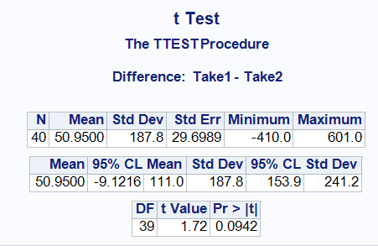
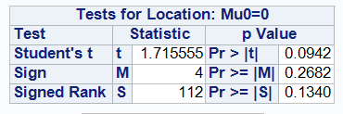
Comparison of the two tests conducted:
Parametric test
Non-parametric test
Two-tailed Wilcoxon signed rank test is not significant with S=112 with an associated two-tailed p-value of p₀= 0.134^{NS} (since it exceeds 0.05).
The data are then consistent with the assumption that population sales mean do not differ systematically between the trained and untrained salespersons.
Paired sample two tailed t-test is not significant with t₀=1.72 & p value p₀=0.0942^{NS}
Hence, We don't have enough evidence to prove that the selling potential has been improved with training and also accept the null hypothesis that no changes in sales receipt.

Slide 5
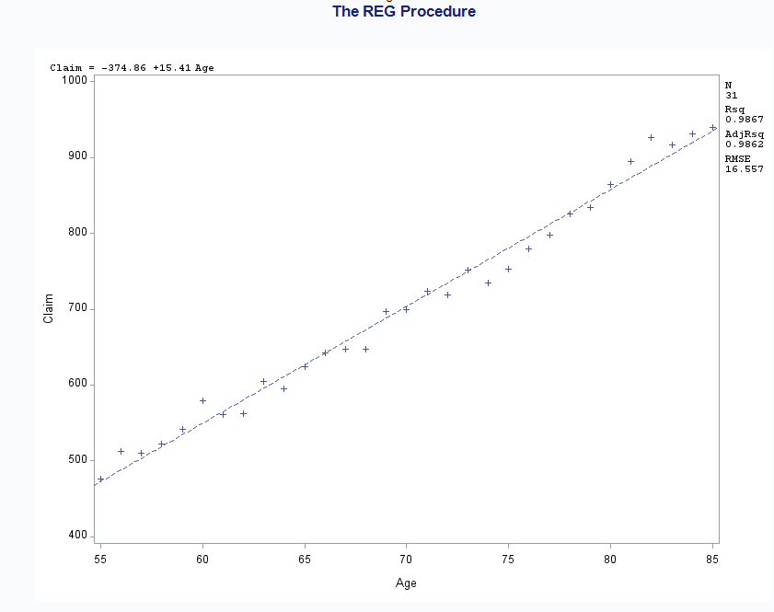
A study for an insurance company to suggest on whether or not to introduce a flat rate travel insurance plan for customers in Age between 50 and 85 years.
Claim(£) vs Age(years) – Scatterplot with regression line:
An approximate straight line confirms the apparent suitability of the linear regression model at this stage.
The test statistic t₀=46.35** with an associated two-tailed p-value P₀< 0.0001. So the obtained result is significant at 0.1% level.
Regression should definitely be 'worthwhile' as the above test proved that the slope is not equal to 'zero'.
Bivariate regression model: Claim = -374.86+15.41Age

Slide 6
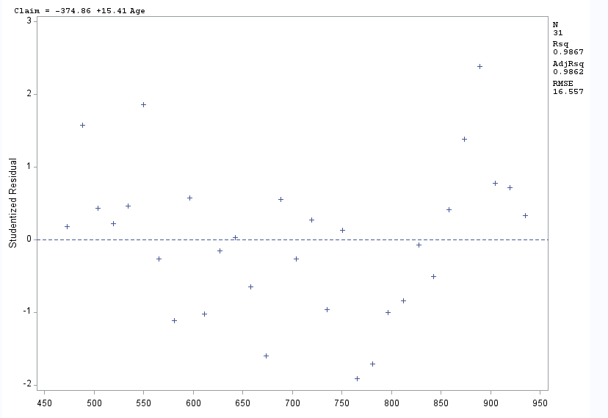
Studentised residuals against Fitted values:
Studentised residuals scatter about zero with approximately equal variance across the entire range of fitted values.
Hence, the plot is consistent with the adequacy of the systematic component of the model.

Slide 7
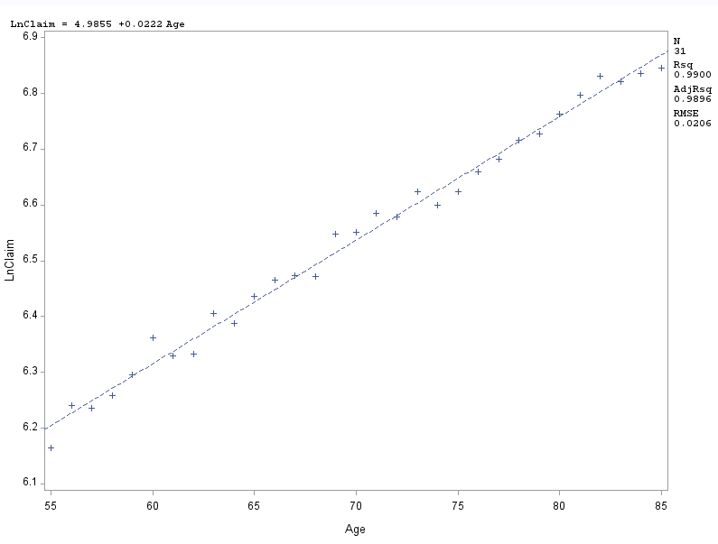
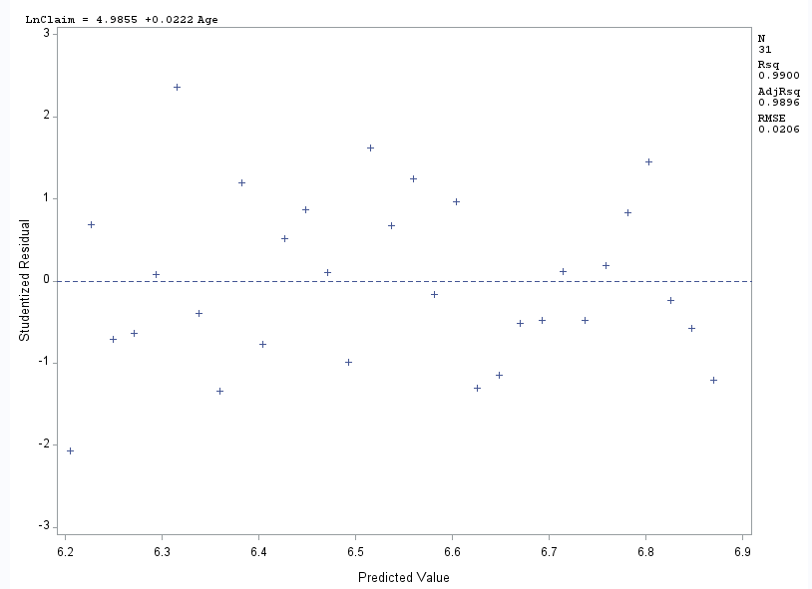
LnClaim vs Age(years) – Scatterplot with regression line:
Studentised residuals against Fitted values:
Linear relationship between LnClaim and Age - As Age increases, LnClaim value increases.
Studentised residuals scatter about zero with approximately equal variance across the entire range of fitted values.
Hence, the plot is consistent with the adequacy of the systematic component of the model.
The test statistic t₀=53.45** with an associated two-tailed p-value P₀< 0.0001. So the obtained result is significant at 0.1% level. Hence, regression is worthwhile.
Bivariate regression model of LnClaim and Age is: Lnclaim=4.9855+0.0222*Age

Slide 8
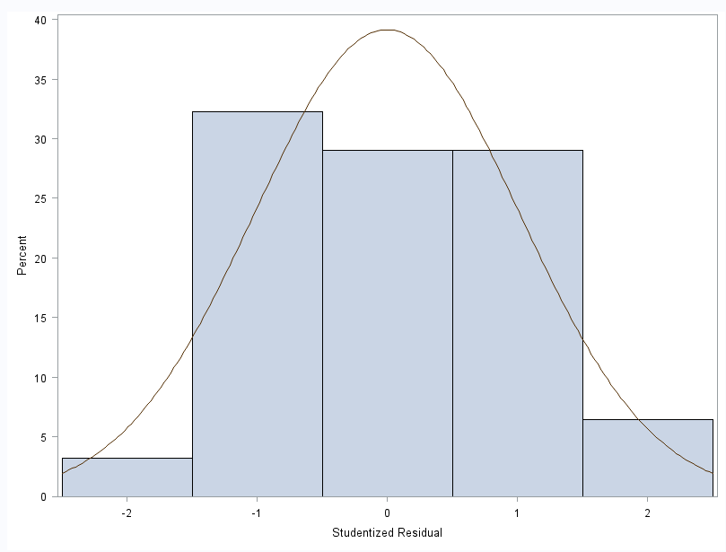
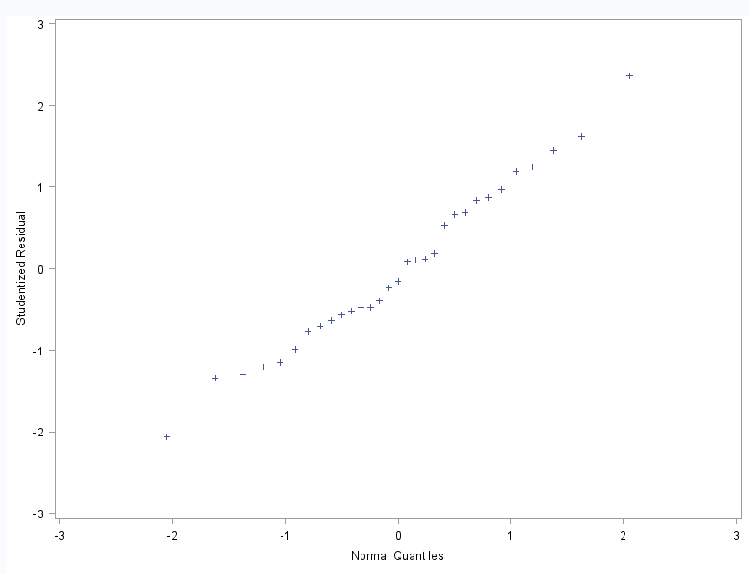
Histogram of studentised residuals:
Normal probability plot of studentised residuals:
Confirms near-normality of random errors.

Slide 9
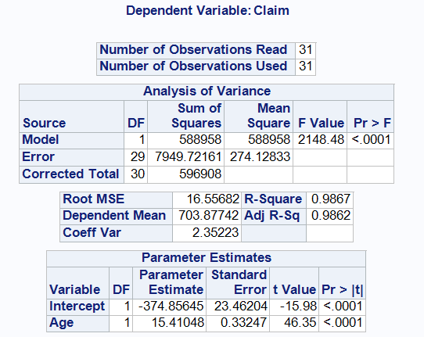
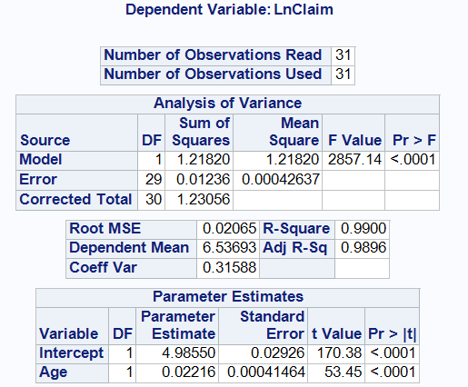
Comparison of Two models obtained:
Claim vs Age:
LnClaim vs Age:

Slide 10
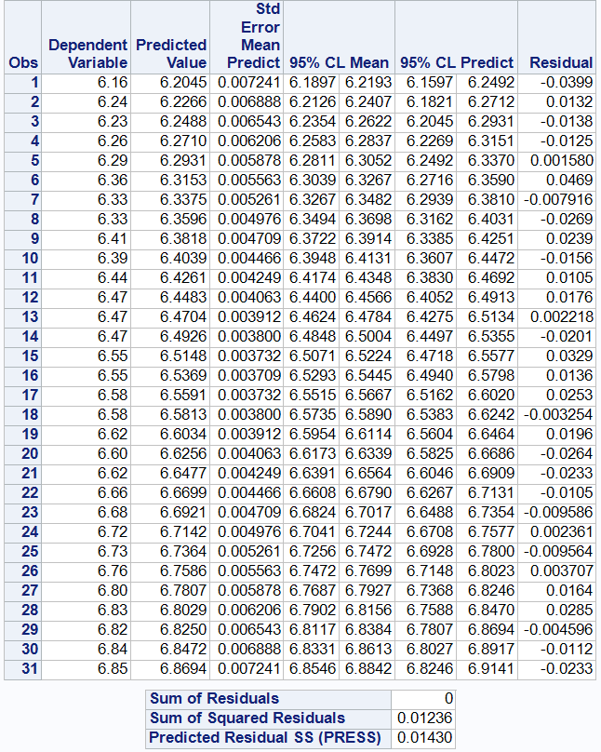
Fitted Model:
Lnclaim=4.9855+0.0222*Age
i.e., intercept = 4.9855
slope = 0.0222
For Age =70;
predicted LnClaim=6.5369; predicted 95% CL for Lnclaim =
6.4940 to 6.5798.
Conclusion:
For Age =70; with 95% assurance, the mean claim amount will range from £684.91 to £695.41

Slide 11
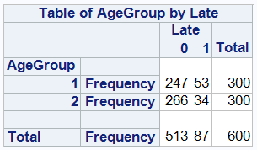
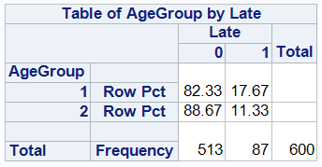
A Detailed analysis for a bank on the late payment proportions between younger & older customers:
Data in the form of frequency distribution:
What does it say?
AgeGroup1(18 to 30 years) has made 53 late payments out of 300. That is:
17.67% Late payments,
82.33% On-time payments.
AgeGroup2(Over 30 years) has made 34 late payments out of 300. That is:
11.33% Late payments.
88.67% On-time payments.
Hence, at a first glance, it looks to be people who are in agegroup1 has made more late payments than in agegroup2. Lets test if this is true.

Slide 12
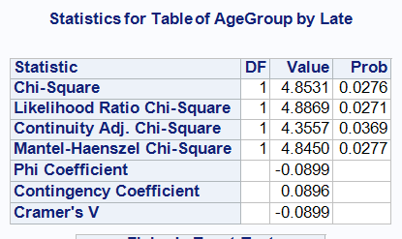
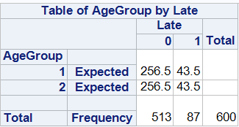
Chi-square test:
Will a Chi-square test be valid?
YES
What does it say?
The observed value of test statistic Chi-square = 4.8531 with 1 associated degree of freedom.
The corresponding two-tailed p-value is P=0.0286*. As this p value lies between 0.01 to 0.05, the chi-square test t is significant at the 5% level.
Expected frequency exceeds well above 5. So chi-square test will be valid.

Slide 13
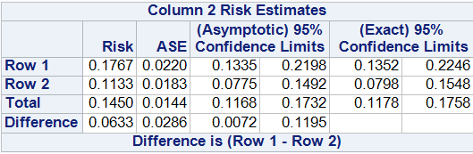
Recommendations from the data analysed:
It is estimated that the late payment rate is about 6.33% greater for younger customers than that of Older customers.
With 95% assurance, the proportion of potential individuals who make late payments in Agegroup1(18 to 30) exceeds that in Agegroup2(over 30) by between about 0.72% and 11.95%
We are only interested in the column2 values estimated above where Late=1 (Late payments).
The estimated population proportions who make late payments is P₁ = 0.18 for younger customers and P₂ = 0.113 for older customers.

Slide 14
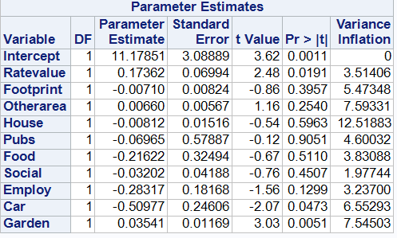
Investigation of the potential value of 40 suburban properties – for a 'pub and restaurant' group:
Checking for Multi-collinearity:
Variance Inflation Factors:
'House' is the only variable that has VIF value more than the cut-off value 10.
Hence, the variable 'House' could be related to one or more of the other explanatory variables.

Slide 15
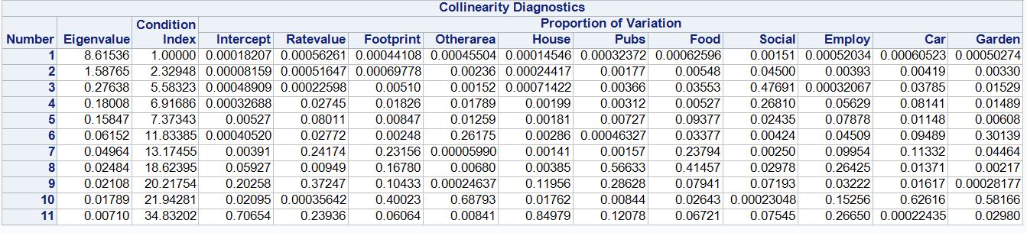
Checking for Multi-collinearity:
Condition Indices:
Condition Index exceeds 30 only in row11, but it doesn't exceed 3 or more times of condition index in preceding row.
In this row11, the explanatory variable 'House' and possibly the intercept have high loadings.
There is some possibility that there might be a collinearity between 'House' and the intercept, considering high VIF value observed for the variable 'House'.

Slide 16
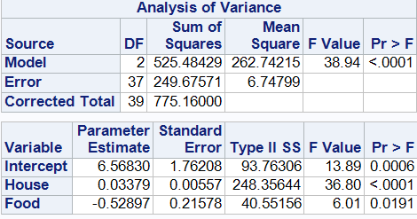
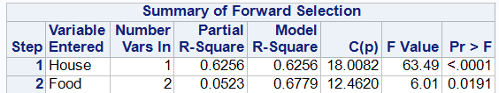
Forward Selection method:
Step1: Variable 'House' Entered: R-Square = 0.6256 and C(p) = 18.0082
Step2: Variable 'Food' Entered: R-Square = 0.6779 and C(p) = 12.4620
No other variable met the 0.0500 significance level for entry into the model.
Fitted regression equation :
value = 6.5683 + 0.03379*(House) - 0.52897*(Food)

Slide 17
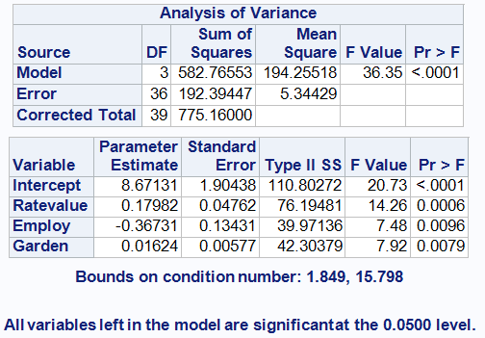
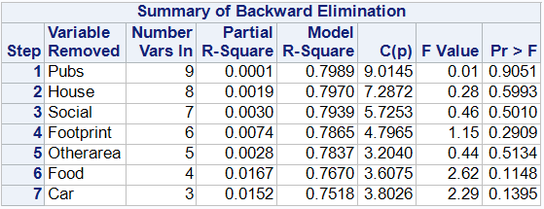
Backward Elimination method:
Step0: All Variables Entered: R-Square = 0.7990 and C(p) = 11.0000
Step1: Variable 'Pubs' Removed: R-Square = 0.7989 and C(p) = 9.0145
Step2: Variable 'House' Removed: R-Square = 0.7970 and C(p) = 7.2872
Step3: Variable 'Social' Removed: R-Square = 0.7939 and C(p) = 5.7253
Step4: Variable 'Footprint' Removed: R-Square = 0.7865 and C(p) = 4.7965
Step5: Variable 'Otherarea' Removed: R-Square = 0.7837 and C(p) = 3.2040
Step6: Variable 'Food' Removed: R-Square = 0.7670 and C(p) = 3.6075
Step7: Variable 'Car' Removed: R-Square = 0.7518 and C(p) = 3.8026
All variables left in the model are significant at the 0.0500 level.

Slide 18
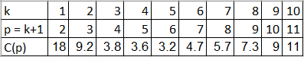
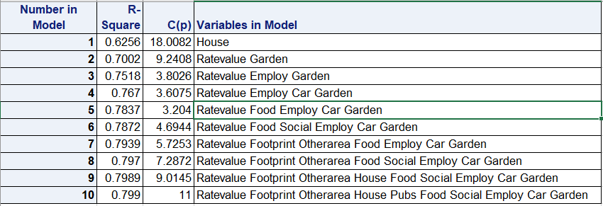

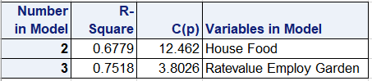
Model Selection using C(p) method:
Reason why I choose the reduced model obtained from Backward elimination method.
Model selected from forward selection method
Model selected from backward elimination method

Slide 19
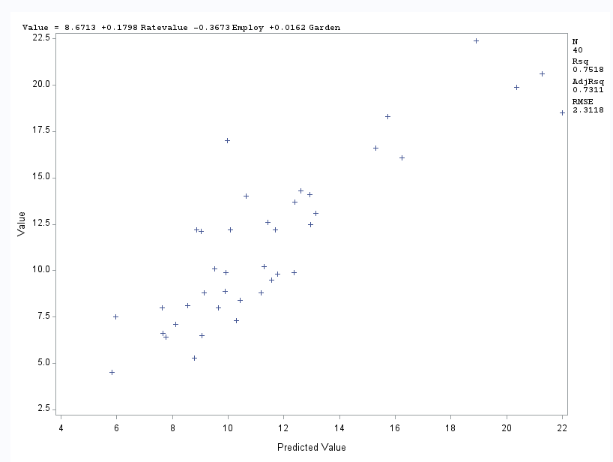
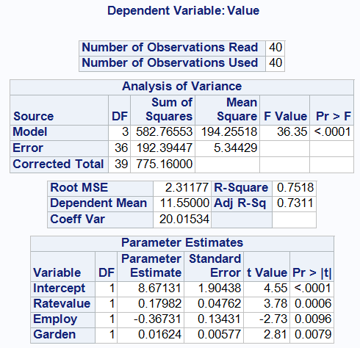
Fitted regression model:
Fitted regression equation :
value = 8.6713 + 0.1798*Ratevalue - 0.3673*Employ + 0.0162*Garden

Slide 20
Investigating the overall validity of reduced model:
Studentised residual vs fitted values:
The studentised residuals (when plotted against fitted values) appear to be reasonably randomly scattered about a mean value of zero, with approximately constant variance across the entire range of fitted values.
Consistent with the adequacy of systematic component of the model, with constant variance assumption.
Studentised residuals vs explanatory variables:
The studentised residuals (when plotted against explanatory variable) appear to be reasonably randomly scattered about a mean value of zero, but not with approximately constant variance across the entire range of explanatory variables(Ratevalue, Employ, Garden).
However, these plots are not primarily suited to discover such variance effects and the more relevant plot of studentised residuals against fitted vales was reasonably satisfactory in this respect.
Histogram of studentised residuals:
Histogram of studentised residuals is based on 40 observations, so should be reasonably reliable.
The histogram suggests that the residuals have a unimodal distribution, but they are moderately positively skewed.
Normal Probability plot:
The normal probability plot of the studentised residuals indeed conform to an approximate straight line of unit slope passing near the origin.

Slide 21
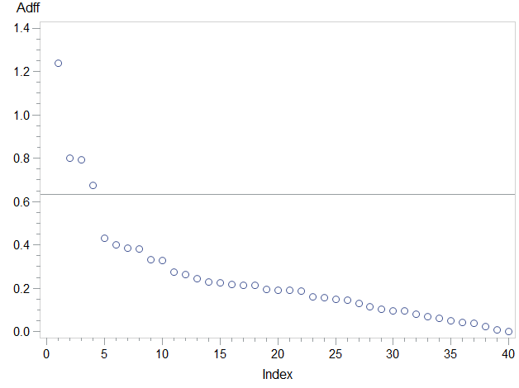
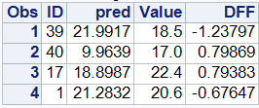
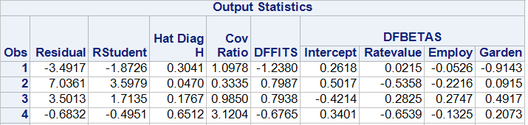
Identifying Potential Influential Observations:
Cut-off values:
Average H = 0.1; cut-off for H > 0.3
|DFFITS| > 2(absolute) or |DFFITS| > 0.6324
Covratio C limits: 0.7 to 1.3
|DFBETAS| > 2(absolute) or |DFBETAS| > 0.316
Totally 4 observations are crossing the |DFFITS| cut-off value of 0.63. But nothing reaches the max limit of 2 or more.
|DFBETAS| value of 2 observations(ID:40 & 17) crosses the limit of 0.316. But none of it goes near 2.
Considering Leverage H, Obs4 (ID: 1) has more H value and obs1(ID:39) just touches beyond 0.3.
As per covariance ratio values obtained, inclusion of observations 2 and 4 (ID:40 & 1) could reduce the precision of the fitted regression equation.

Slide 22

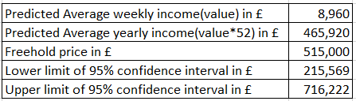
Applying the fitted regression model:
Leverage value is lower than average 0.1. So, the model should produce reliable prediction
The predicted average weekly income from 'The Good King James' is £8,959.55 with associated 95% prediction limits of £4,145.56 to £13,773.5
Is the predicted average yearly income greater than or equal to the advertised freehold price?

